Slide 1


Dr. Mark Hardy, Dean
College of Science, Engineering and Technology
Jackson State University

Slide 2

Origins
  National Science Foundation DUE Projects
Current Efforts
  Mississippi State Cyber Crime Initiative
  National Science Foundation CCLI Project
  Center for Defense Integrated Data
  Massie Chair in Computer Security
Future Efforts

Slide 3

Initial focus of Computer Security at Jackson State University
  Expansion and Enhancement of the Center of Excellence in Information Assurance (IA) program (NSF-DUE 0210167)
  Award Period: 8/15/2002 – 7/31/2005
  Cyber Service Scholarship Program
  (NSF-DUE 0210169)
  Award Period: 8/15/2002 – 7/31/2006

Slide 4

Project overview:
  Partnership between Mississippi State University (MSU), an NSA Center of Excellence in Information Assurance Education (COE/IAE) Jackson State University (JSU) and the University of Kansas (KU)
  Goal: through collaboration and cooperation increase JSU’s and KU’s capacity in information assurance and to strengthen the COE/IAE program at MSU

Slide 5

Accomplishments:
  Curriculum
    Spring 2003 & Spring 2004
      a split-level CSC 499/539 Computer Security course was offered electronically by a faculty member from Mississippi State University and coordinated by a faculty member at JSU
    Spring 2005 – current
      CSC 499/539 Computer Security course taught by a faculty member at JSU

Slide 6
Accomplishments:
  Laboratory Facilities
      A small lab of 8 machines, with two LAN segments (four machines in each segment) connected by a switch was established at JSU campus
      MSU provided a set of laboratory exercises that the Computer Security students could perform

Slide 7
Certification Program
  Spring 2004
    Department of Computer Science at JSU was certified by the Committee on National Security Standards
    NSTISSI standards 4011 (Information Systems Security (INFOSEC) Professionals) and 4014 (Information Systems Security Officers)

Slide 8

Project Overview:
  Scholarship program initiated first at MSU and extended to JSU year 2 of the grant
  Goal: Increase the number of graduates prepared for Federal employment at Mississippi State and Jackson State Universities

Slide 9

Accomplishments:
  During academic years 2003-04, 2004-05 and 2005-06, four students (4 African-Americans – 3 female, 1 male) at JSU completed concentrations in Information Assurance and Computer Security
  Two students completed internships at the FBI, one at NASA, one at the US Army Corp of Engineers Research and Development Center and the U.S. General Accountability Office (GAO)
  Students accepted job offers and began employment at the CIA, GAO, and the ARMY CERDEC Command

Slide 10



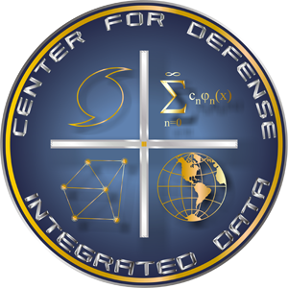


Slide 11

Partnership with Mississippi State University
DOJ Funding ($9M since 2005)
An MSU coordinated cyber crime training center that trains local and state law enforcement in the US in security, cyber crime and infrastructure protection.
State of the art integrated laboratory in Jackson, MS at the Siller’s Building. FBI, Secret Service, Local LE, Attorney General’s Office, JSU, & MSU cooperate in a Cyber Crime Fusion Center.
Provide low/no cost training for law enforcement
officers, prosecutors, and trial judges on current technical issues associated with computer crime.

Slide 12

Computing Principles Short Course (for Law Enforcement Personnel with minimal Computing Experience)
Community Outreach Presentations (to educate parents about Social Networking, CyberCrime, Cyber Stalking and their impact on youth)
Computer Forensics Special Topics Course (multidisciplinary course for undergraduate and graduate students)
Network Forensics Short Course (for students, computing and law enforcement professionals)

Slide 13

Project Overview: continued partnership between Mississippi State and Jackson State University to further cyber crime efforts and to support the cyber crime fusion center
Additional staff person will be hired to assist efforts in Education, Research, Collaboration
Award Period: 10/1/2010 – 6/30/2011

Slide 14
Education
  Teach introductory computer forensic classes in a week long course to law enforcement officials for the National Forensics Training Center located in Jackson, MS and at other locations
Research
  Develop semi-automated tool that assists digital forensic investigators and examiners with organizing case facts during a digital forensic examination
Collaboration
  Expand relationships with Mississippi Attorney General’s Office and FBI computer forensic investigators and examiners

Slide 15
NSF CCLI Program Funding
Incorporating Systems Security and Software Security in Senior Projects
(S⁴-SP Program)
Award Period: 09/15/2010 to 08/31/2013
Award Amount: $199,986

Slide 16

With the rapid growth in technology, it is of utmost importance to address the security and assurance of our computing and networking infrastructure on which all aspects of human lives have become strongly dependent.
According to the US-Computer Emergency Readiness Team (CERT), “most successful attacks result from targeting and exploiting known, non-patched software vulnerabilities and insecure software configurations, many of which are introduced during design and coding.”
Given the trends we are facing in system and software vulnerabilities in industry and government, we need to train students with a broader understanding of security in the context of the entire software development lifecycle.

Slide 17

Develop course modules in the areas of systems security, software security and cryptography
Integrate and use the course modules in the Software Engineering and Senior Capstone Project courses
Develop a Virtual Security Lab (VS Lab) making use of as much as possible off-the-shelf currently available equipment at JSU and the lab can be remotely used by other institutions to test the security course modules and the Senior projects at zero cost
Develop a sequence of two elective courses on Systems Security and Advanced Information Security

Slide 18

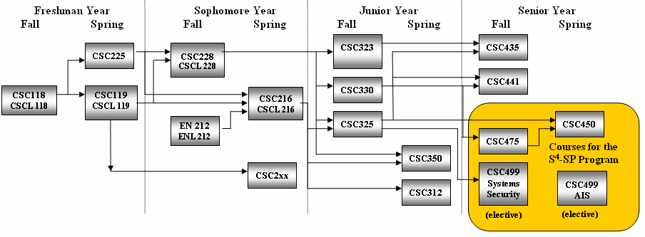
CSC 325 – Operating Systems (Pre-requisite)
CSC 499 – Systems Security and
Software Security (every Fall)
CSC 450 – Senior Project
CSC 475 – Software Engineering
CSC 499 – Advanced Information
Security (every Spring)

Slide 19

PI: Dr. Natarajan Meghanathan
Co-PIs: Dr. Hyunju Kim, Dr. Loretta Moore
Research Assistants:
  Mr. Jeremy Bouldin (Undergraduate)
  Mr. Alexander Roy Geoghegan (Undergraduate)
  Ms. Mounika Challagundla (Graduate)
Graduate Students Working for their Thesis on the Virtual Security Lab/ VMWare
  Mr. Sandeep Thumma and Mr. Ishtiaq Ali

Slide 20
CENTER FOR DEFENSE INTEGRATED DATA

Slide 21
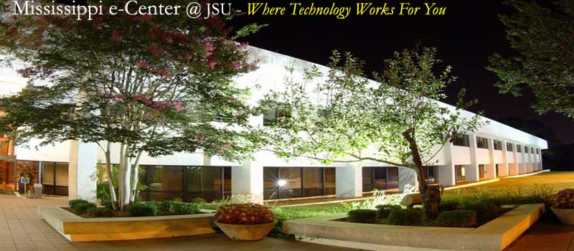
OVERVIEW
Established in 2004 as the decision-support research arm for JSU’s School of Engineering
Projects supporting: Department of Homeland Security, Army Space and Missile Defense Command, Navy Oceanographic Office, US Transportation Command, and NASA
DoD contract requires secret-level clearance for all staff

Slide 22




FUNDED PROJECTS
US Army Space and Missile Defense Command - Vertical Integration (VI)
  Fused data technology to automate complex decision support functionalities
DHS Disaster Response Intelligent System (DRIS)
  Incident management solution for first responders
US Army Corps of Engineer Research and Development Center (ERDC)
  GIS-based Decision Support Aid for Urban Land Classification
NASA Headquarters and NASA EPScoR
  Agency-wide GIS portal for NASA Headquarters
  Sensors development for Multi-Rover Planetary Exploration

Slide 23
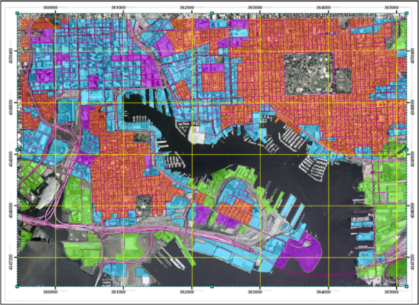
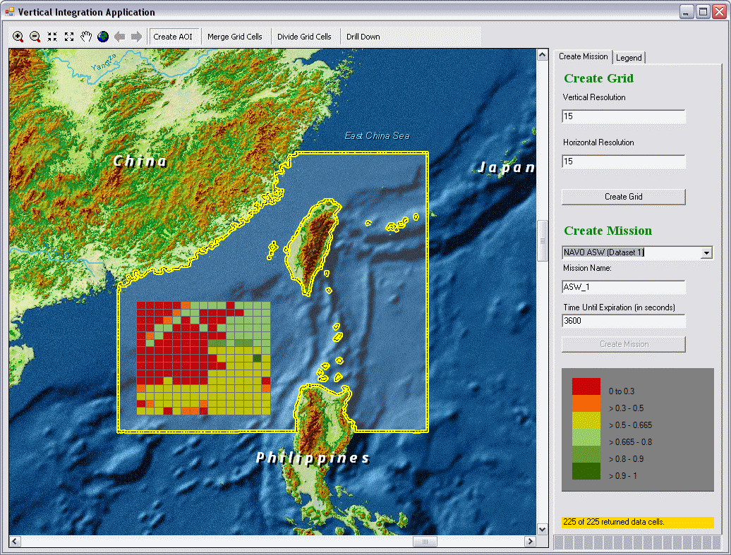
CDID CORE CAPABILITIES
Focus Areas
  Software Development
  Information Assurance
  Cyber Security
  GIS Mapping and Analysis
  Advanced Visualization
  Predictive Model Integration
  Data Fusion
  Wireless Sensor Networks
Application Areas
  Risk Assessment & Threat Analysis/Detection
  Transportation Security
  Homeland Security/Emergency Management

Slide 24
CDID SECURITY RESEARCH
Information Assurance
  Secure software development - agile methods
  Software penetration testing
  Refactoring for security
  Secure software architectures
  Security patterns
Computer/Network Security
  Wireless sensor networks
  Cyber-physical security
  Cyber forensics
  Threat analysis

Slide 25

Capacity enhancing effort in Cyber Security and Information Assurance
Goal: Enhance education and research in cyber security at JSU
  Integrate security in all phases of CS core curriculum
  Expand cyber security research efforts in department and centers
3 year program

Slide 26

Conduct cutting-edge scientific research and technical investigations
Promote interaction, collaboration and partnerships between the private sector, federal agencies, major research institutions and other HBCUs
Lecture on new frontiers in science and technology
Serve as chief scientists/engineers providing expert advice to the public and private sectors
Mentor young investigators and act as role models for engineering students

Slide 27

Activities
  Curriculum development – new IA/CS courses
  Course development – for non-CS students
  Program expansion - Political Science, Business Info Systems, and Criminal Justice departments

Slide 28

Develop and maintain secure software systems
  developing secure architectures
  enhancing software development practices to ensure security is “built in”
  reengineering existing systems

Slide 29

Mark G. Hardy, Ph.D. (PI) – Dean, College of Science Engineering and Technology (CSET)
Loretta A. Moore, Ph.D. (Co-PI) – Department Head, Computer Science
Gordon W. Skelton, Ph.D. – Associate Professor & Director, Center for Defense Integrated Data
Byron J. Williams, Ph.D. – Associate Director & Chief Software Engineer, Center for Defense Integrated Data
Hyunju Kim, D.Sc. – Assistant Professor, Computer Science

Slide 30
Massie Chair Annual Budget
Senior Personnel (4) $104,306.00
Administrative Support (1) $ 10,560.00
Student Support (Academic Year) (3) $ 27,000.00
Summer Student Internship Support (3) $ 42,000.00
Equipment $ 9,000.00
Travel $ 18,000.00
Materials & Supplies $ 3,954.00
Publication Costs $ 780.00
Total Direct Costs $215,600.00
Indirect Costs $ 34,400.00
Total Costs $250,000.00

Slide 31

Certification by the Committee on National Security Standards
Information assurance and cyber security certification
  Computer security, forensics, cryptography (core courses)
  Computer networks, operating systems, databases (electives)

Slide 32

Reviewed current CS courses
  Conducted a review on NSTISSI 4011 and 4016
    NSTISSI 4011 (communications basics, automated information systems basics, security basics, NSTISS basics, system operating environment, planning and management, polices and procedures)
    NSTISSI 4016 (information system life cycle activities, countermeasures identification, implementation and assessments, certification and accreditation, testing and analysis)

Slide 33
  Identified the CS courses that cover the topics of the two standards
  Conducted review on current course syllabi
Identified missing topics
  Located topics within standards that are not covered by the current CS courses
  Assigned the topics to related CS courses
    Brought a need for developing new CS courses

Slide 34
Updating course syllabi and materials
  Based on the findings from the previous step and the two standards
Identifying needs for new CS courses and cooperating with other departments
  Working with other university centers or departments
    In order to cover more topics
  Developing multiple tracks in the certification program
    In order to recruit more students and to provide more concentrations
  Developing new CS courses to cover the topics that are not covered by current CS courses
    For example, a course to cover developing security policies and procedures

Slide 35
National Center of Academic Excellence in Information Assurance Education

